Slide 1
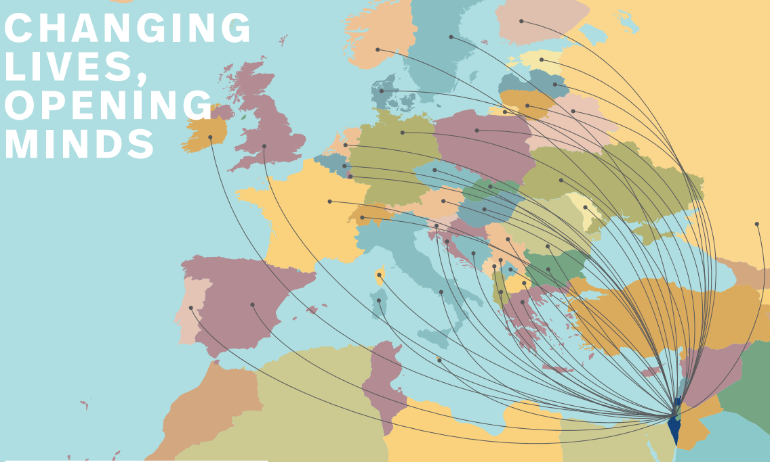

Notes:
או אולי תרומתה של התכנית לפיתוח מערכת ההשכלה הגבוהה

Slide 2
Overview
What has Erasmus+ achieved so far in Israel?
How can you participate or take your partnership one step further?
  Different actions – focus on Mobility with non eu partners -
  Find your partners
  Ensure good partnership
The future of Erasmus+
  What can we expect
Questions

Slide 3
Overview
2014-2020
The Erasmus+ programme opens many new doors for Israel
Mobility (ICM) Students & Staff
Since 2018 Mobility for Traineeship
Capacity Building
Jean Monnet
Youth
EMJMD
HEREs
2008 - 2013
Tempus
Erasmus Mundus
Jean Monnet
2020/21
Launch of new Erasmus+

Slide 4

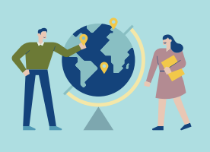
KA 1 Mobility
84% of Israeli HEIs cooperate with over 350 Universities in Europe
Over 14500
individuals participated so far

Slide 5
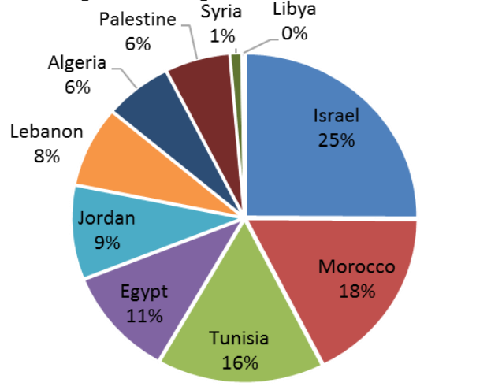

KA 1 Mobility
Israel

Slide 6
KA 1 Mobility to Europe
2126
550

Slide 7
KA 1 Mobility to Israel
1896

Slide 8


KA 2 Cooperation
20 Capacity Building Projects under Erasmus+

Slide 9
How to take your partnership one step further?
European Universities
Joint Degrees
Your Ambition
Joint Programmes
Strategic Cooperation Framework
Regular Student Mobility
Cooperation Projects
Erasmus+ Individual Student / Staff Mobility
Individual Student / Staff Mobility
Your Long Term Strategy

Slide 10



How it works: 1. Mobility (ICM KA107)
Student Mobility 3-12 Months
Contribution to Travel Cost
Contribution to Costs of Stay
Staff Mobility for Teaching 5 – 90 Days
Contribution to Travel Cost
Per diem
Staff Mobility for Training 5 – 90 Days
Contribution to Travel Cost
Per diem
Organizational Support (per participant): Share it with your Partner!

Slide 11


How it works: 1. Mobility (ICM KA107)
Bilateral Inter-Institutional Agreements
Joint Application -> Submitted by EU partner
Joint Implementation -> Managed by the EU partner
Application process: Quality indicators, NA budget for the region
24 or 36 months implementation
Develop a joint calendar for implementation

Slide 12






How it works: 1. Mobility with non academic partners (internship)
For Students
For professionals
+
Training and Teaching
Only for Teaching in EU

Slide 13







How it works: 2. Capacity Building
National Projects
Why?
Meet National Priorities
Your Partners are key to a successful project
Multi- national Projects
Who ?
Up to 1 Million Euro for Projects from 2-3 Years
What?
Notes:
צריך להזכיר שניתן שיהיו יותר מוסדות מהמדינות השותפות אך לא יותר ממדינות התכנית

Slide 14
Useful Resources
Mobility:
The HANDBOOK here
The ICM Guide here
Example for Interinstitutional Agreement here
Find your internship https://erasmusintern.org/
Projects:
Last years Call for Proposal https://eacea.ec.europa.eu/erasmus-plus/funding/capacity-building-higher-education-2019_en
The projects Results platform: https://ec.europa.eu/programmes/erasmus-plus/projects/

Slide 15





Who’s who?
Your colleagues in Israel:
  Many newcomers, small teams, but clearly enthusiastic
The Israeli HEIs:
  Many new strategies, building facilities, small funds
The Israeli Student:
  Age, culture, religion, almost no outbound mobility
The Israeli administrative staff
  Enthusiastic about mobility, in many cases not very internationalized
The Israeli academic staff:
  international research, not rewarded for teaching abroad

Slide 16







Find ways to meet!
Streamline Processes?
Build internal QA
Use OS?
Contact the NEO
Build a structured work plan
Use staff mobility
Add your partners to the Mobility tool ?
About 84% of HEIs participate in E+ Mobility
Joint preparation of application
Prepare students and staff
From “yes why not” to strategic partnerships
QA
Synchronize working structures and calendar
Notes:
It is of course not a linear process, but to make my point and highlight the challenges - it should be enough
Organizational support
QA: add your partners as read only!!!

Slide 17
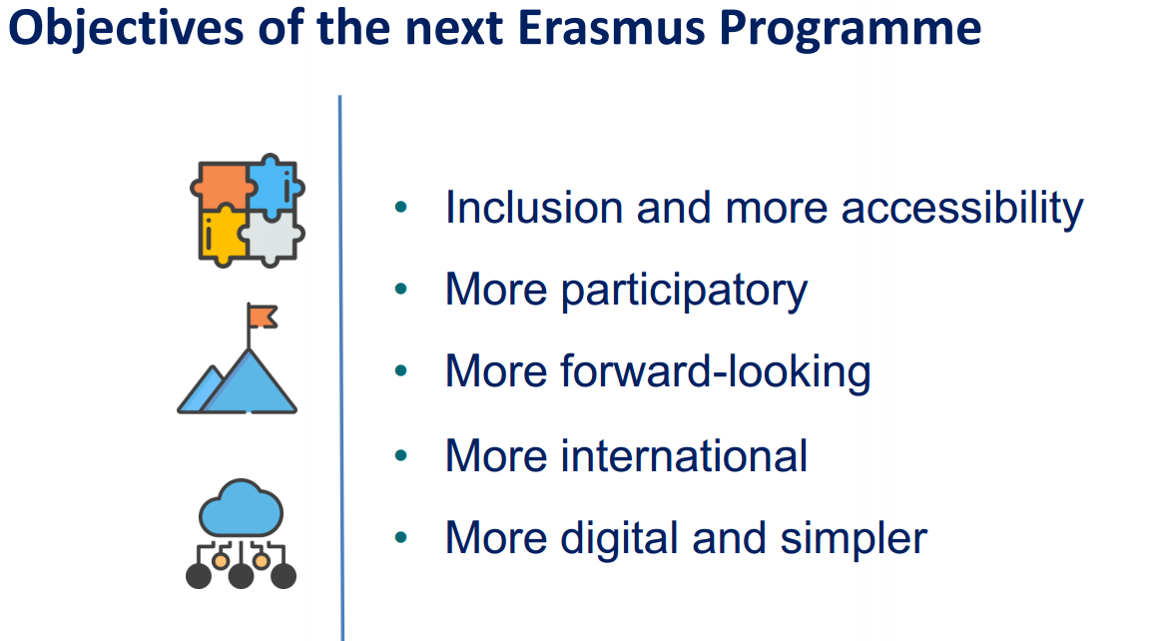
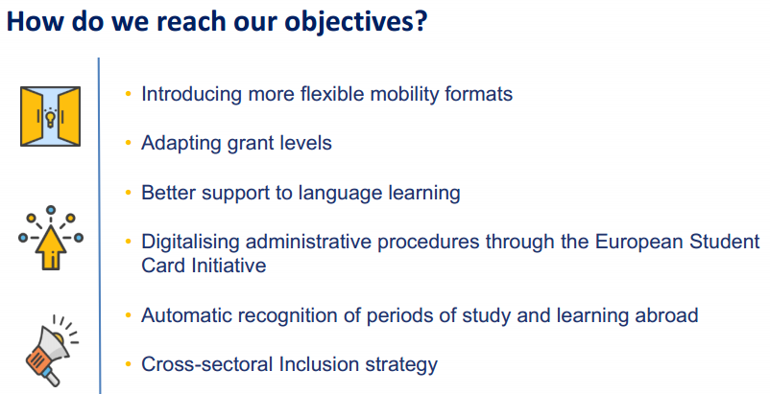
The Future of Erasmus+, what can we expect ?

Slide 18
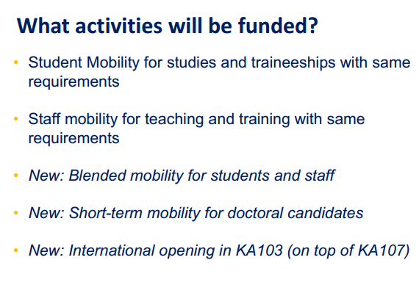
The Future of Erasmus+, what can we expect ?

Slide 19
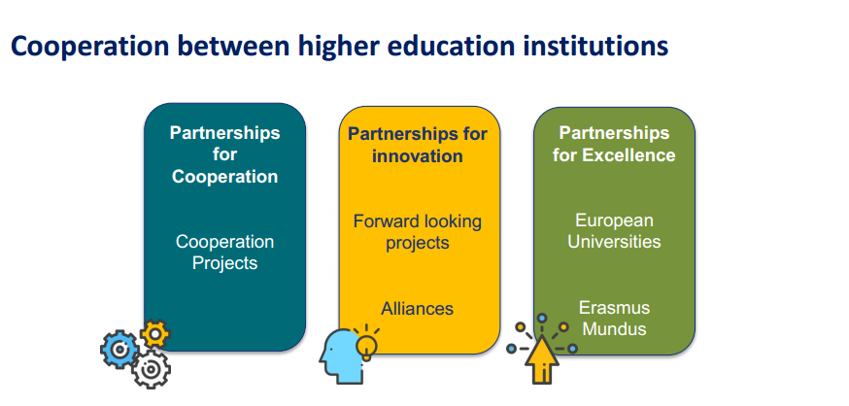
The Future of Erasmus+, what can we expect ?

Slide 20
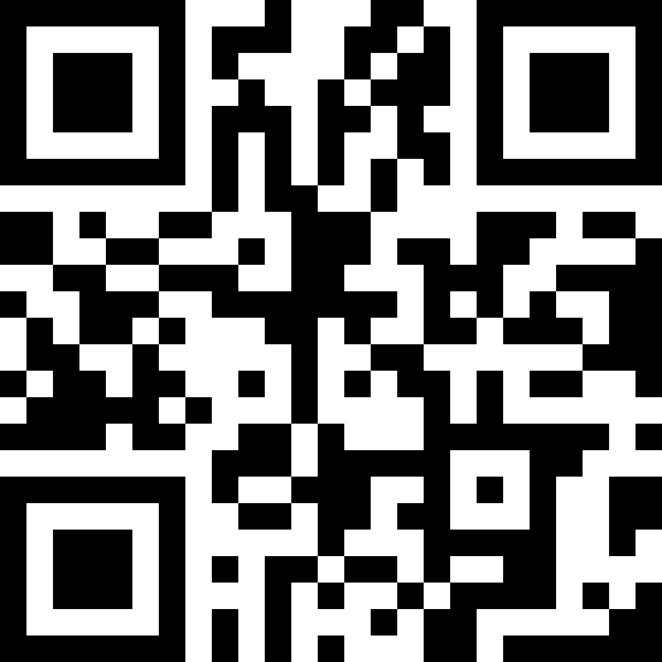


Thank you for your attention!
You are welcome to contact us at any time!
erasmusplus@che.org.il
www.erasmusplus.org.il

